Slide 1
Survey data analysis Week 44: “Nonresponse”
© Peter Lugtig

Slide 2
Today
Lecture on NR
Exercise working with weights

Slide 3
Literature today
The increasing problem of nonresponse
Luiten, de Leeuw & Hox (2018)
Details of weighting methods
Kalton and Flores-cervantes (2003)

Slide 4
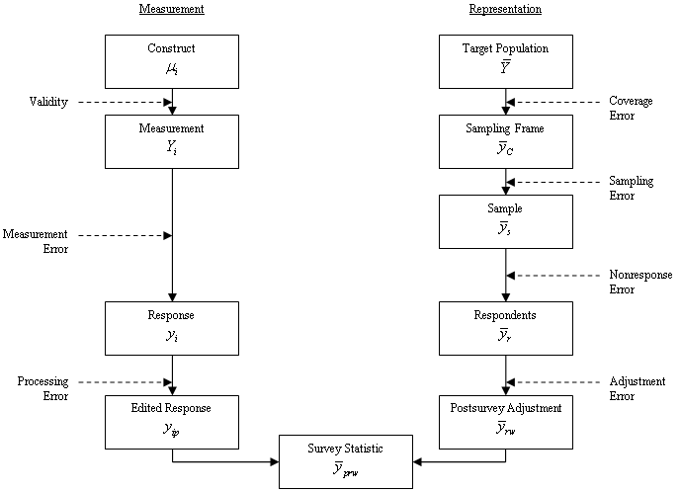
Total Survey Error (TSE) Framework
(Groves et al. 2009, p.48)

Slide 5
Nonresponse in LFS over time
Based on Luiten, De leeeuw & Hox (2018) nternational Nonresponse Trends across Countries and Years: An analysis of 36 years of Labour Force Survey data. Survey Insights: Methods from the Field. Retrieved from https://surveyinsights.org/?p=10452.

Slide 6
European Social Survey Nonresponse
From: Beullens, K., Loosveldt G., Vandenplas C. & Stoop I. (2018).Response Rates in the European Social Survey: Increasing, Decreasing, or a Matter of Fieldwork Efforts? Survey Methods: Insights from the Field. Retrieved from
https://surveyinsights.org/?p=9673

Slide 7
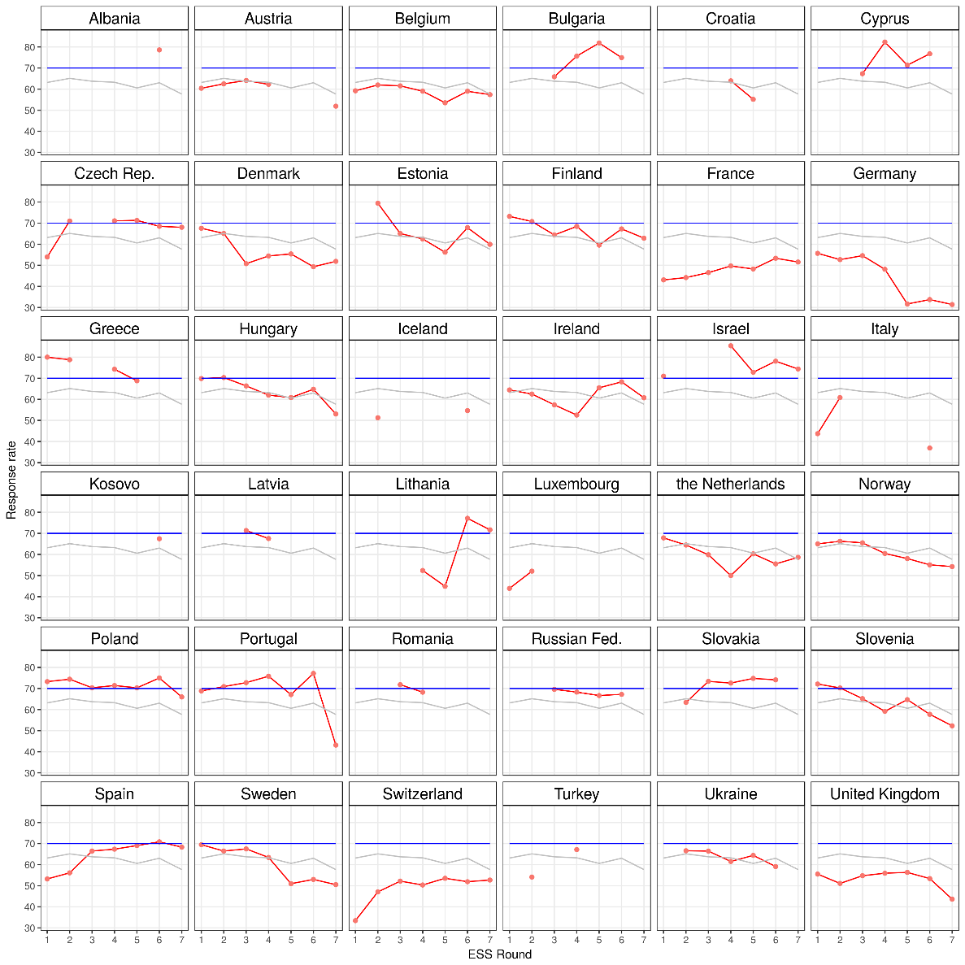
ESS: RR variation in response rate

Slide 8
Four main types of nonresponse
In survey research we typically distinguish four types of nonresponse:
Unit nonresponse The sample unit (e.g. person, household, institution) was sampled, i.e. belonged to the gross sample, but did not participate in the survey.
Item nonresponse The sample unit was sampled and interviewed, but failed to provide answers to all of the survey items.
Attrition The sample unit was sampled and initially interviewed for a longitudinal surveys, but did not complete all waves of the survey.
Partial (household) nonresponse The sample unit was sampled and at least one member of the unit interviewed. However, at least one member of the unit did not participate.

Slide 9
Main causes of nonresponse
Unit nonresponse non-contact, refusal, unable
Item nonresponse refusal, don’t know, breakoff
Attrition non-location, non-contact, refusal, unable
Partial (household) nonresponse non-contact, refusal, unable

Slide 10
How to prevent nonresponse
Things you noticed in your adopted survey?

Slide 11
How to prevent nonresponse
A good questionnaire, invitation letter, etc.
keep it simple, keep it simple, test it
Incentives
Preferable unconditional, and cash
3. Multiple contact attempts
4. Multiple modes (e-mail, mail, phone, f2f)
5. Refusal conversion
- Interviewer training
6. Be responsive to questions/remarks/problems

Slide 12
Correction for nonresponse
Item nonresponse
Rich information on individual
Partial (household) nonresponse
Proxy-answers, information on household
Attrition
Information from earlier waves
Unit nonresponse
Weak individual information (only frame)
Imputation
weighting

Slide 13
What is nonresponse bias?
Nonresponse bias occurs when the sampled units (e.g. individual, household, business …) are not or only partially observed (e.g. interviewed)
AND observed units are systematically different from unobserved units.

Slide 14
MCAR, MAR, NMAR
Missing Completely At Random (MCAR): The responding units are a random subsample of the gross sample.
Missing At Random (MAR): The responding units are not a random subsample of the gross sample. However, the auxiliary information x renders the relationship between y and response r independent.
Not Missing At Random (NMAR): The responding units are not a random subsample of the gross sample. In addition, the auxiliary information x does not render the relationship between y and response r independent.

Slide 15
Missing data mechanisms
MCAR
X
Z
R
Y

Slide 16
Missing data mechanisms
MCAR
MAR
X
Z
R
Y

Slide 17
Missing data mechanisms
MCAR
MAR
X
Z
R
Y

Slide 18
Missing data mechanisms
MCAR
MAR
MNAR
X
Z
R
Y

Slide 19
Example: income
Unit response rates in surveys:
~5-50%
Nonresponse: 50-95%!
Item-nonresponse for income question:
~25%
What do we have: MCAR, MAR, or MNAR?
Discuss!

Slide 20
Item nonresponse (weeks 46,47)
Use covariates (x) at level of respondent
Strongly related to both response (R) and Y
MCAR, MAR, MNAR models
X
Z
Example item missings in income:
Education, wealth, age, gender, value of house (X)
To predict income (Y) and
Take away relation R-Y
R
Y

Slide 21
Unit nonresponse
Few covariates (x) at level of respondent
Often only address, or e-mail
Weakly related to both response (R) and Y
X
Z
Example Unit Nonresponse:
Only use address (house price)
Can predict income (Y), but
Cannot explain relation R-Y
Not successful in NR correction
R
Y

Slide 22
Why weight?
Sampling: selection probabilities may differ
-> design weights
Coverage: sampling list may not cover target population
Nonresponse: not all people in sample will end up in data
-> adjustment weights for coverage/NR

Slide 23
Design weights (repeat from weeks 39-42)
SRS: equal probabilities
-> no design weights
Stratified, cluster, multistage
-> need design weights for unbiased estimates
See slides for those weeks
Weights not needed if:
you specify correct svydesign (ids=~, strata=~, ….)
You use a HT-estimator (fpc = ~inclusionprobabilities)

Slide 24
The idea behind weighting
X values at level of (sub)population
One weighting model for all substantive analysis
In imputation model often Y-specific.
X
Z
R
Y

Slide 25
Population level data?
1. Sampling frame (nonresponse)
Address.
Can be enriched (e.g. use google streetview)
Statistics Netherlands: admin data
2. Population level statistics (coverage + NR)
Gender (50/50), age, income, region, nationality

Slide 26
Weighting methods
1. Propensity score weighting
Often using frame information from sample
2. post-stratification
3. linear weighting (GREG)
4. Raking
2-4 often based on population statistics

Slide 27
Nonresponse bias
Deterministic
It is a function of the nonresponse rate M/N and the difference between the respondents’ r and the nonrespondents’ m population values.
Probabilistic
It is a function of the correlation σ of the survey outcome y with the response propensity ρ and the mean response propensity measured in the target population (Bethlehem 2002).
Note that nonresponse bias is always estimate-specific!

Slide 28
Propensity weighting
Deterministic
It is a function of the nonresponse rate M/N and the difference between the respondents’ r and the nonrespondents’ m population values.
Probabilistic
It is a function of the correlation σ of the survey outcome y with the response propensity ρ and the mean response propensity measured in the target population (Bethlehem 2002).

Slide 29
Propensity-score weights
For propensity-score weights (logistic regression) models estimate the response propensity (predicted probability) of each sample unit given a set of covariates.
Response rate for all linear combinations of for example:
response[0;1] ~ gender+age+region+typehouse
Weight is the scaled inverse of the predicted response propensity of each sample unit.
Design weight = sample inclusion probability
Propensity weight = participation probability

Slide 30
Post-stratification
Deterministic approach
Uses population statistics
Correct multiple error sources in one go
Nonresponse
Coverage

Slide 31
Post-stratification: fictitious example
Survey distribution
Population distribution
Age | Gender
 | Male | Female
16-25 | 6.1% | 5.9%
26-35 | 12.8% | 10.7%
36-45 | 19.5% | 16.9%
46-55 | 10.0% | 9.5%
56-65 | 3.9% | 4.7%
Age | Gender
 | Male | Female
16-25 | 10.0% | 10.0%
26-35 | 10.0% | 10.0%
36-45 | 10.0% | 10.0%
46-55 | 10.0% | 10.0%
56-65 | 10.0% | 10.0%
Male respondents aged 16-25 receive a weight of w = 0.1/0.061 = 1.639

Slide 32
Post-stratification: fictitious example
Survey distribution
Population distribution
Age | Gender
 | Male | Female
16-25 | 6.1% | 5.9%
26-35 | 12.8% | 10.7%
36-45 | 19.5% | 16.9%
46-55 | 10.0% | 9.5%
56-65 | 3.9% | 4.7%
Age | Gender
 | Male | Female
16-25 | 10.0% | 10.0%
26-35 | 10.0% | 10.0%
36-45 | 10.0% | 10.0%
46-55 | 10.0% | 10.0%
56-65 | 10.0% | 10.0%
Female respondents aged 36-45 receive a weight of w = 0.1/0.169 = 0.592

Slide 33
When does weighting work?
Target variables vary little within strata
Response probabilities vary little within strata
Target variable and response probabilities are not correlated within strata (=MAR)
Example Unit Nonresponse:
Income varies little within gender and age (male/female)
Given gender and age, there is little variation in response rates
Given gender and age, there is no correlation between probability of response and income

Slide 34
When does weighting work?
Target variables vary little within strata
Response probabilities vary little within strata
Target variable and response probabilities are not correlated within strata (=MAR)
Example Unit Nonresponse:
Income varies little within gender and age (male/female)
Given gender and age, there is little variation in response rates
Given gender and age, there is no correlation between probability of response and income
Unlikely

Slide 35
How to weight better…
Use more variables in weighting
Gender, age, …
To improve relation X-> R and X->Y
Problems:
1. There may be empty strata
Combine empty strata
Use fewer variables
2. The population distribution across all variables may not be available

Slide 36
Raking aka multiplicative weighting
Raked weights adjust the individual distributions of key survey variables to known joint population distributions.
Raking is an iterative process.

Slide 37
Raking: fictitious example
Survey distribution
Population distribution
Gender
Male | 52.3%
Female | 47.7%
Gender
Male | 50.0%
Female | 50.0%
Age
16-25 | 12.0%
26-35 | 23.5%
36-45 | 36.4%
46-55 | 19.5%
56-65 | 8.6%
Age
16-25 | 20.0%
26-35 | 20.0%
36-45 | 20.0%
46-55 | 20.0%
56-65 | 20.0%

Slide 38
Raking: fictitious example
Survey distribution
Population distribution
Gender
Male | 52.3%
Female | 47.7%
Gender
Male | 50.0%
Female | 50.0%
Age
16-25 | 12.0%
26-35 | 23.5%
36-45 | 36.4%
46-55 | 19.5%
56-65 | 8.6%
Age
16-25 | 20.0%
26-35 | 20.0%
36-45 | 20.0%
46-55 | 20.0%
56-65 | 20.0%
The survey distributions are iteratively adjusted to the age and gender population distributions until an equilibrium is reached.

Slide 39
Alternative: Linear weighting
Aka Generalized Regression Estimator (GREG) or calibration
Fixes problem of empty population cells
Fixes problem of population distribution
Sample Population
 | Male | Female | Total
Young | 23 | 15 | 38
Middle | 16 | 17 | 33
Old | 13 | 16 | 39
Total | 52 | 48 | 100
 | Male | Female | Total
Young | ? | ? | 43
Middle | ? | ? | 30
Old | ? | ? | 27
Total | 51 | 49 | 100%
With thanks to Jelke Bethlehem for this example

Slide 40


Linear weighting
Assume there are p continuous auxiliary variables
Similar to propensity score weighting (other link-function)
Required: vector of population means
Estimate: conditional RR (most likely) for combinations of categories of p
Best value for B (least squares):
Sample-based estimate (full response):
With thanks to Jelke Bethlehem for this example

Slide 41
Linear weighting
Linear weighting computations
Weight for young female = 1 +.033+.161=1.185
Gender | Age | X1 | X2 | X3 | X4 | X5 | X6
Male | Young | 1 | 1 | 0 | 1 | 0 | 0
Male | Middle | 1 | 1 | 0 | 0 | 1 | 0
Male | Old | 1 | 1 | 0 | 0 | 0 | 1
Female | Young | 1 | 0 | 1 | 1 | 0 | 0
Female | Middle | 1 | 0 | 1 | 0 | 1 | 0
Female | Old | 1 | 0 | 1 | 0 | 0 | 1
Sample prop |  | - | .52 | .48 | .38 | .33 | .39
Population prop. |  | 1.00 | .51 | .49 | .43 | .30 | .27
Weights |  | 1.00 | -.033 | .033 | .161 | -.095 | -.066

Slide 42
GREG or Raking?
GREG
Clear model
Variance of estimators can be computed
Can include continuous weighting variables (e.g. age)
Assumptions of regression model (normality, linearity)
Weights may become negative (causing computational problems)
Raking
No model, no assumptions
No variance estimation
Only categorical variables

Slide 43
Total Survey Error (TSE) Framework
(Groves et al. 2009, p.48)
Notes:
Die Fehler erst nach und nach einblenden!!!!

Slide 44
Combining weights
Designing weights can have several stages. For example:
The design weight is derived from the sampling frame (and the household selection during fieldwork).
Propensity-score weights are calculated using information from the sampling frame and the response indicator.
The data are post-stratified to known population distributions.
Weights can be combined : W1 * W2 * W3 = Wt
Often only the total Weight included in public datasets
No detailed information on sampling design or nonresponse correlates
Or svydesign for sampling plan, use weights for nonresponse and coverage

Slide 45
Next weeks
Next week: designing weights
In 2+3 weeks -> imputation (by Stef van Buuren)
Assignment 2

